Slide 1
A Hitchhiker’s guide to Ethics
Computing and Internet Edition
Because there’s nothing that gives you more freedom than the introduction chapter
By David Schirduan
(pronounced shir-due-waneanduendued)

Slide 2

An Example
The book uses ATMs
ATMs are boring
Just like the formatting in this presentation
I’ll talk about twitter instead, because it’s WAY more fun to say

Slide 3
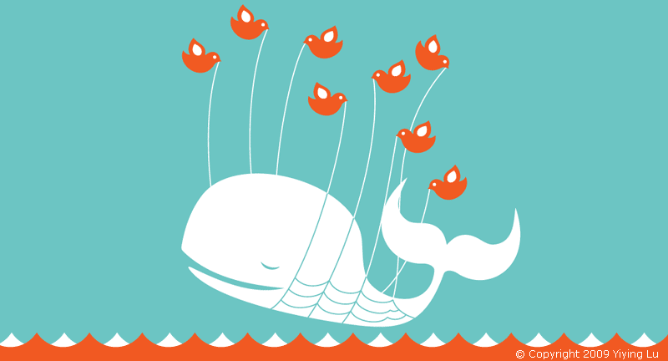
Problems
Privacy
Mis-information
Mass Communication
Overload
Solutions
Tabloids/FB did it first
Biased News
Social Communication already present
More choice, more options

Slide 4
Privacy
Controlling Technology
Freedom of Speech
Error and Risk
Intellectual Property
Professional Ethics
Crime
Work/Employment

Slide 5
The Problems of the Future...Today!
Old Problems in a new context
Adapting to new technology
Multiple Solutions
Trade-offs
Global Boundaries
Personal Choices VS. opinions VS. Law

Slide 6
Ethical Assumptions and Limitations
People act rationally, and out of their own free will.
  Can ethics explain why kids love Cinnamon Toast Cruch?
    no....no it can’t.
General statements, not specific
  You can’t use ethics to justify that one time at band camp
Invented or discovered?
  Quidditch or Science?

Slide 7
Ethical Assumptions
Examines basic right/wrong actions on a large general scale
Good actions work out as best as possible, for as many people as possible
  So far “Don’t kill people” has worked pretty well for us....at least until the zombie apocalypse.
  Which is another subject that ethics won’t cover. Not until Chapter 27: Post Apocalyptic Ethics.
  It’s a REALLY short chapter, trust me.

Slide 8

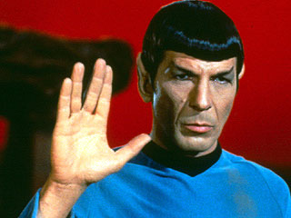
Ethical Approaches
Deontological(that’s totally how it’s pronounced)
  Immanuel Kant
    I Kant think of anything else to add here
  Duty, absolute rules that apply universally
  Hard-line stance determined by logic, reason
    Spock Seal of Approval
  No other goal/ motivating factor
    Being good is it’s own reward
    A better society is a bonus.
    Like finding extra money in your
    clothes during laundry

Slide 9
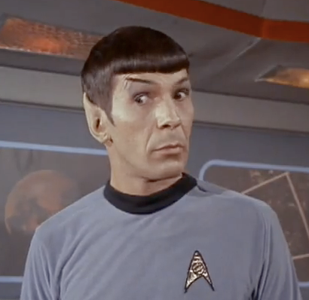
Ethical Approaches
Utilitarianism
  John Stuart Mill
  “Utility” (humans call it happiness)
  “Good” things increase overall Utility
    Do I really need to explain what “bad” things do?
  Very variable guidelines, depends on circumstances
  Can’t know all Consequences
  “Needs of the Many....”
    Last Star Trek reference, I promise!
      For this slide at least.....

Slide 10
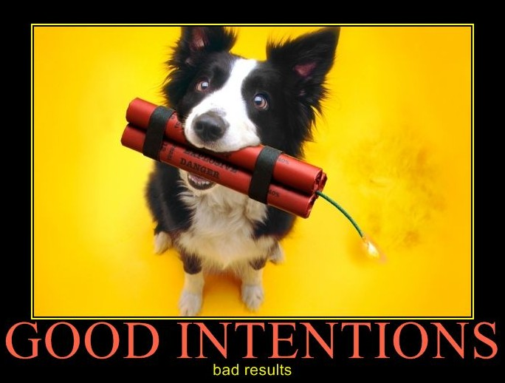
Ethical Approaches
Natural Rights
  Give people freedom
    Even well-intentioned people
  Voluntary improvement
    “I refrain from killing people because I WANT to, not because there are people with guns who will stop me”
No Simple Answers
  If it was easy, you wouldn’t need me to make a fool of myself up here.

Slide 11
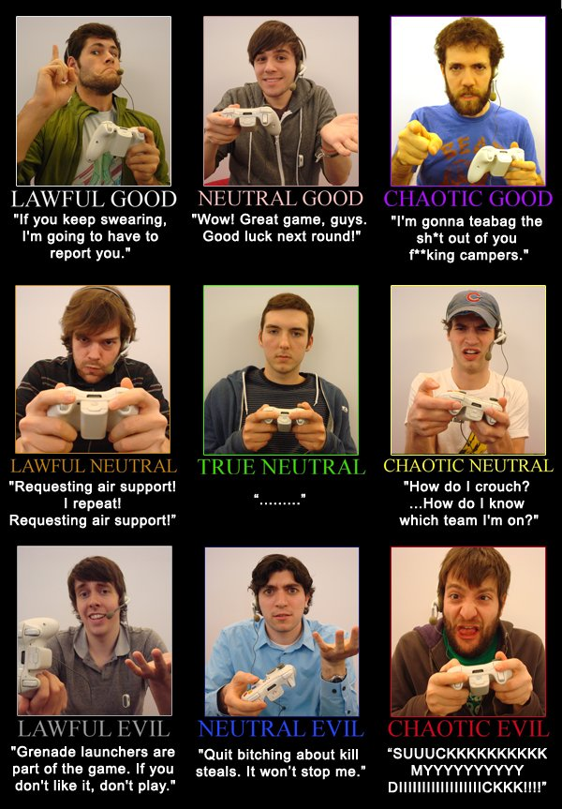
Distinctions
World isn’t Black/White
  Grey areas
Right, Okay, Wrong
Obligatory
Acceptable
Prohibited

Slide 12
Distinctions
“Negative” rights
Act freely
No interference
Life, speech, religion
“Liberties”
“Positive” rights
Laws
Abide by rules
Taxes
“Claim Rights”

Slide 13
Distinctions
Harm != Wrong
  Causing harm isn’t necessarily wrong
    Disciplining a child, or confronting a friend
  Lack of harm isn’t always right
    Crackers who infiltrate privacy
Goals vs Constraints (Ends vs Means)
  Both must be examined
Personal Preference != Ethics
  Ethics are impersonal by definition
    Piracy (I kinda stole this idea from the book)

Slide 14
Law and Ethics
Laws are separate from ethics...kinda
  Some laws reinforce ethics
    I’m pretty sure “Don’t kill” is in the books somewhere.
  Some laws don’t connect to ethics
    Unless skateboarding downtown is ethically wrong
      It might be a bit unwise though.....
        Seriously, have you seen how people drive downtown?
  Many shades of gray
  Depends on the law

Slide 15
Conclusion
(Finally, I thought he’d never shut up!)
Ethics applied in many areas
Reaction to changes
  (you know, like computers and stuff)
Operates on assumptions
Several approaches and attitudes
Distinctions are important
Minimalist Presentations aren’t boring
They are efficient!

Slide 16
This class is not about teaching conclusions.
It’s about learning how to examine situations and understand the implications and impact that technology has.
It’s also about gaining knowledge, as well as extending your viewpoint and scope of life.

Slide 17
Questions?
If you want to be picky, I guess THIS is the conclusions slide.
But I said earlier that this class isn’t about conclusions....
Oh well. I’m sure no one noticed.

